Slide 1
Accelerators based on Intel® Arria® FPGA
Notes:
After an optimized IR format model has been generated by MO, the next step is to implement the model into your computer vision application. This is where you will start to use the Inference Engine APIs.

Slide 2
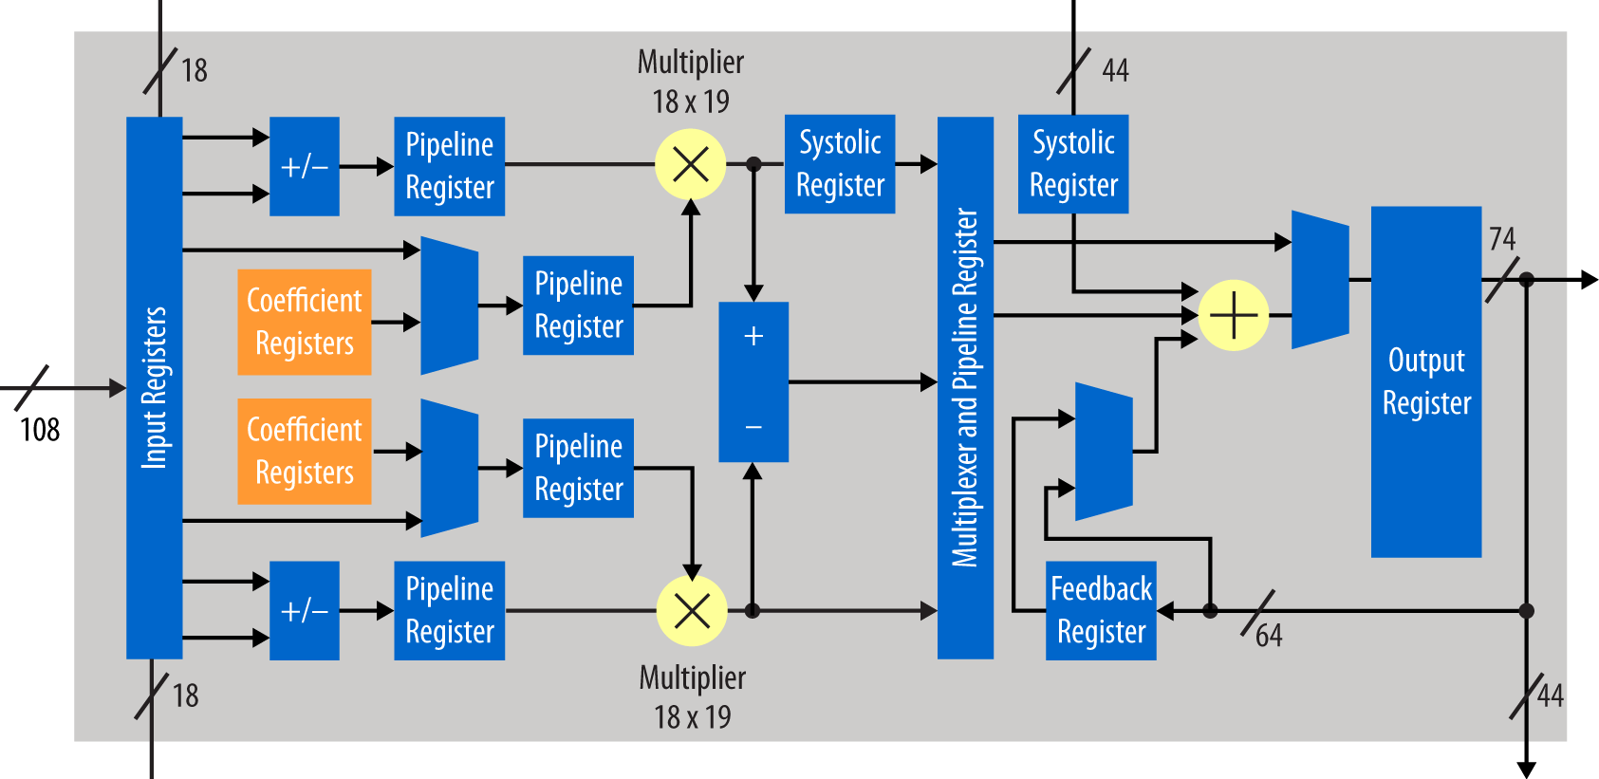
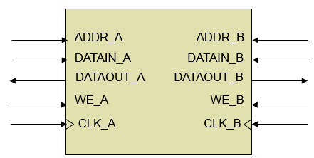
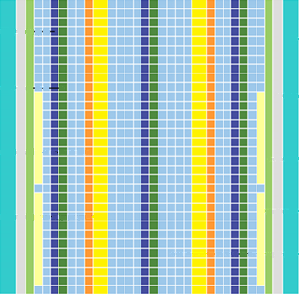
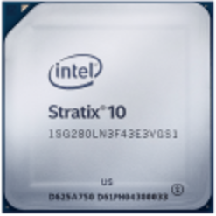
FPGA Overview
DSP Block
Memory Block
Field Programmable Gate Array (FPGA)
Millions of logic elements
Thousands of embedded memory blocks
Thousands of DSP blocks
Programmable routing
High speed transceivers
Various built-in hardened IP
Used to create Custom Hardware!
Logic Modules
Programmable Routing Switch
Notes:
FPGA, short for Field Programmable Gate Array, unlike other devices such as CPU, GPU or VPU, FPGA does not have any dedicated hardware logic blocks designed for processing any kind of general or special tasks. Instead, there are millions of logic elements, thousands of embedded memory blocks, and DSP blocks, along with programmable routings, high-speed transceivers, and build-in hardened IPs, for users to create the custom hardware.
Because of the discrete programmable logic blocks are electronically wired, FPGAs are ideal for parallel systems where multiple tasks must be performed simultaneously, and for performing specific tasks requiring timely results. The functionality programmed to FPGA can be updated multiple times.

Slide 3
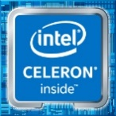

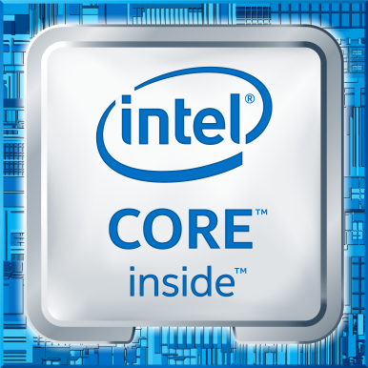

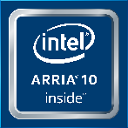


Inside Intel® Distribution of OpenVINO™ toolkit
Deep Learning
Traditional Computer Vision
Intel® Deep Learning Deployment Toolkit
OpenCV*
Samples
Model Optimizer Convert & Optimize
IR
Inference Engine
Optimized Inference
For Intel® CPU & GPU/Intel® Processor Graphics
+ samples
IR = Intermediate Representation file
Tools & Libraries
Open Model Zoo
Intel & Public Pretrained Models
Demos
Model Downloader
Accuracy Checker
Increase Media/Video/Graphics Performance
Intel® Media SDK Open Source version
OpenCL™ Drivers & Runtimes
Deployment Manager
Post Training Optimization Toolkit
Benchmark App
For GPU/Intel® Processor Graphics
Optimize Intel® FPGA (Windows & Linux)
DL Workbench
DL Streamer
FPGA RunTime Environment (from Intel® FPGA SDK for OpenCL™)
Bitstreams
OS Support: CentOS* 7.4 (64 bit), Ubuntu* 16.04.3 LTS (64 bit), Microsoft Windows® 10 (64 bit), Yocto Project* version Poky Jethro v2.0.3 (64 bit), macOS* 10.13 & 10.14 (64 bit)
Intel® Architecture-Based Platforms Support
Intel® Vision Accelerator Design Products &
AI in Production/ Developer Kits
An open source version is available at 01.org/openvinotoolkit (some deep learning functions support Intel CPU/GPU only).
OpenVX and the OpenVX logo are trademarks of the Khronos Group Inc.
OpenCL and the OpenCL logo are trademarks of Apple Inc. used by permission by Khronos
Notes:
As we mentioned in the overview session, FPGA support is a separate installation package, in addition to the regular components in the OpenVINO toolkit, FPGA distribution also contains the Intel® FPGA Deep Learning Acceleration Suite, which includes the FPGA runtime environment and the pre-built bitstreams for uploading to the FPGA.
The bitstream is a file that contains the programming information for an FPGA, and FPGA must be programmed using a specific bitstream for it to behave as an embedded hardware platform. In our case here, to run the inference workload on FPGA, if we switch to a different topology model, we will need to load a different bitstream to FPGA, which is equal to switching to another embedded hardware specially designed to process the new topology inferencing.
The reason we provide the bitstreams is for users to take advantage of the FPGA without going through the lengthy traditional FPGA development process, which needs both a lot of engineering efforts and a relatively long time for recompiling an FPGA.

Slide 4

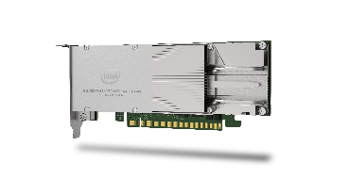

Intel® Distribution of OpenVINO™ Toolkit with DLA User Flows
Application
Developer
Intel® Distribution of OpenVINO™ toolkit
Design
Run
Program
Turnkey Software Deployment Flow
Bitstream Library
Neural Net
Choose from many precompiled FPGA Images
Or
Custom create
FPGA bitstream
FPGA Architecture Development Flow
User Customization of DLA Suite
Source Code
IP Architect
Design
Compile
Intel® FPGA SDK for OpenCL™
Notes:
Now let’s look at the workflows for using DLA.
If you’re a Deep Learning Deployment software application developer, you would implement your software using the OpenVINO toolkit. You would choose the optimal turnkey solution from the Bitstream Library of many precompiled FPGA images, then run your application on the CPU and FPGA. All of your efforts are focused on the software and the FPGA just acts as an accelerator behind the scenes.
Or, if you are an FPGA architect, you can use the intel FPGA DLA Acceleration suite and the Intel FPGA SDK for OpenCL to create a custom FPGA bitstream that suits your needs. Here you can choose between primitives to include as well as vectorization factor of the convolution processing engines, or you can even write your own deep learning primitives using OpenCL which are then synthesized and compiled into an FPGA image. The software application then will be able to access the custom bitstream using the same OpenVINO inference engine API.

Slide 5
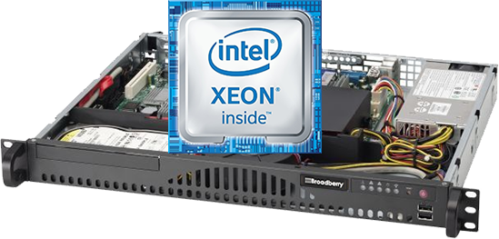

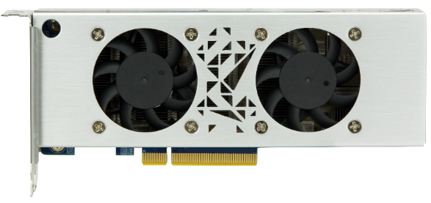
Machine Learning on Intel® FPGA Platform
Acceleration Stack Platform Solution
Edge Computing Solution
ML Framework (Caffe*, TensorFlow*)
Software Stack
Hardware Platform & IP
ML Framework (Caffe*, TensorFlow*)
Software Stack
Hardware Platform & IP
Application
Application
DL Deployment Toolkit
DL Deployment Toolkit
DLA Runtime Engine
DLA Workload
DLA Runtime Engine
DLA Workload
OpenCL™ Runtime
FPGA Interface Manager
OpenCL™ Runtime
OpenCL™ BSP
Acceleration Stack
OpenCL™ BSP Driver
Intel® Xeon® CPU
Intel® Programmable Acceleration Card
Intel® CPU
Intel® Vision Accelerator Design with FPGA
Intel® FPGA Acceleration Hub
Intel® Vision Accelerator Design Products
Notes:
The software and hardware to use the two FPGA boards with OpenVINO are shown here.
On the left is what the software and hardware stack would look like for DL Inference execution on the FPGA-based Programmable Accelerator Cards or PAC over PCIe in the data center. The deep learning deployment toolkit can be used over the Intel Acceleration Stack for an Intel Xeon processor and FPGAs. At the top left, there’s the user Deep Learning inference application. The application is using the OpenVINO toolkit. The Inference Engine plugin will load the FPGA-specific DLA runtime engine, which is built on top of the OpenCL framework leveraging the Acceleration Stack which is a collection of software firmware and tools which makes it easy to deploy Intel FPGAs for workload optimization in the data center. The DLA runtime engine interacts with the DLA workload on the FPGA which contains the various Deep Learning primitives. The interface on the hardware side is handled by the Intel Generated FPGA interface manager containing prebuilt IP using defined interfaces.
On the right is the edge computing solution. Here the software stack is identical to the left but at the bottom, instead of the acceleration stack, you have the OpenCL BSP Driver. On the Vision Acceleration PCIe card with FPGA, the interfaces to the CPU is prebuilt as part of the FPGA OpenCL BSP. Again, the hardware is seamlessly hidden from the inference application in the OpenCL layers.

Slide 6

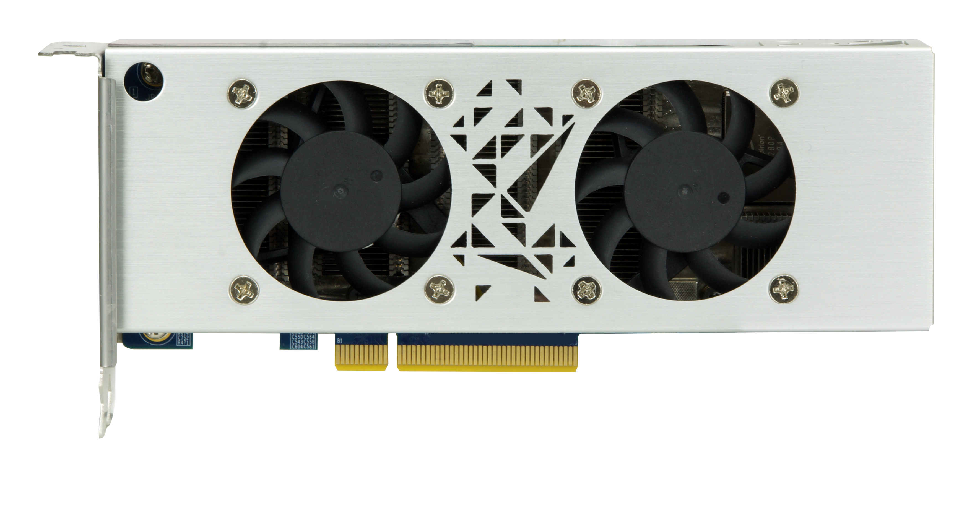

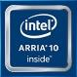
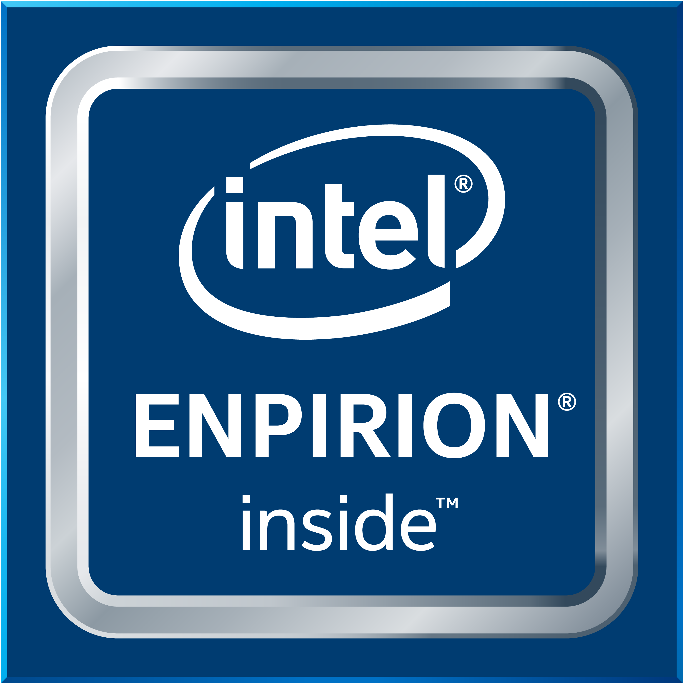
Intel® Vision Acceleration Design With Intel® Arria® 10 FPGA Key differentiators
High performance, low latency
Flexibility to adapt to new, evolving, and custom networks
Supports large image sizes (e.g., 4K)
Large networks (up to 4 billion parameters)
Wide ambient temperature range (0° C to 65° C)
24/7/365 operation
Long lifespan (8–10 years)
Mustang-F100-A10
Notes:
This is the accelerator card we showed on the right side of the previous page. The Mustang-F100-A10 with the PCIe x8 interface, 8GB onboard DDR4 memory, supports Ubuntu 16.04.3 LTS 64-bit, CentOS 7.4 64-bit, and Windows 10.

Slide 7
Intel® FPGA Deep Learning Acceleration Suite
DDR
DDR
CNN inference acceleration engine for topologies executed in a graph loop architecture
AlexNet, GoogleNet, SqueezeNet, VGG, ResNet*, MobileNet*, Yolo, SSD, …
Software Deployment
No FPGA compile required
Run-time reconfigurable
Customized Hardware Development
Custom architecture creation w/ parameters
Custom primitives using OpenCL™ flow
Feature Map Cache
Memory
Reader
/Writer
Convolution PE Array
Crossbar
Config
Engine
prim
prim
prim
custom
Notes:
Now we can take a look at the actual hardware architecture being programmed to the FPGA. For the computer vision use cases, we are mostly using Convolution Neural Networks, so no matter how different the topologies, there are always Convolution layers which are also the most computing and time-consuming parts.
So across all the bitstreams, they share the similar DLA library architectures as we showed on this page, which include a Convolution Processing Elements Array for the convolution layers, a crossbar for communicating with other primitives or kernels for processing other types of layers, more and more primitives are constantly added to support more layers, and a feature map-cache used for buffering the input and output during the computation. The Config Engine is used for controlling the execution, and the Memory Reader/Writer connects to the onboard DDR memory.

Slide 8
Support for Different Topologies
Adapts to support new or evolving networks
Feature Map Cache
Memory
Reader
/Writer
Feature Map Cache
Memory
Reader
/Writer
Convolution PE Array
Convolution PE Array
vs
Crossbar
SoftMax
LRN
Concat
Flatten
Crossbar
Config
Engine
Config
Engine
ReLU
Norm
MaxPool
Reshape
ReLU
Norm
Permute
MaxPool
Notes:
With the different architecture in mind, it’s important to choose the optimal FPGA image because there is a tradeoff between features and performance. If you use a generic FPGA image that can support many different types of primitives as on the right, then you’ll have less space left for the convolution PE array, where on the left, choose the image with only the primitives you need, and you’ll have much bigger size left for both the Convolution PE array as well as the Feature map stream buffer. This will result in much higher performance.

Slide 9
Optimize for Best Performance
Tradeoff between size of Feature Map cache and convolutional PE array
Feature Map Cache
Memory
Reader
/Writer
Feature Map Cache
Memory
Reader
/Writer
Convolution PE Array
vs
Convolution PE Array
Crossbar
Config
Engine
Crossbar
Config
Engine
ReLU
Norm
MaxPool
ReLU
Norm
MaxPool
Notes:
There’s also tradeoff of between the Convolution PE array and Feature Map Cache, with a larger size Convolution PE array on the left, definitely will have a faster computation, but less spaced feature map cache might break the input or output data into multiple slices which will slow down the throughput; on the contrary, a smaller sized Convolution PE Array with larger Feature Map Cache might not suffer the data transferring issue, but Convolution computation becomes the bottleneck.

Slide 10
DLA Architecture: Built for Performance
Feature Map Cache
Memory
Reader
/Writer
DDR
Maximize Parallelism on the FPGA
Filter Parallelism (Processing Elements)
Input-Depth Parallelism
Winograd Transformation
Batching
Feature Stream Buffer
Filter Cache
Choosing FPGA Bitstream
Data Type / Design Exploration
Primitive Support
DDR
Conv
PE Array
DDR
DDR
Crossbar
Config Engine
ReLU
Norm
Max
Pool
Execute
Stream Buffer
Convolution /
Fully Connected
ReLU
Norm
MaxPool
Notes:
Next, let’s look at the machinery of the DLA Library architecture, layers are executed in a ring execution format. Data just keeps looping through using or bypassing the primitives that are needed for each layer, the data between layers stay on the FPGA.

Slide 11
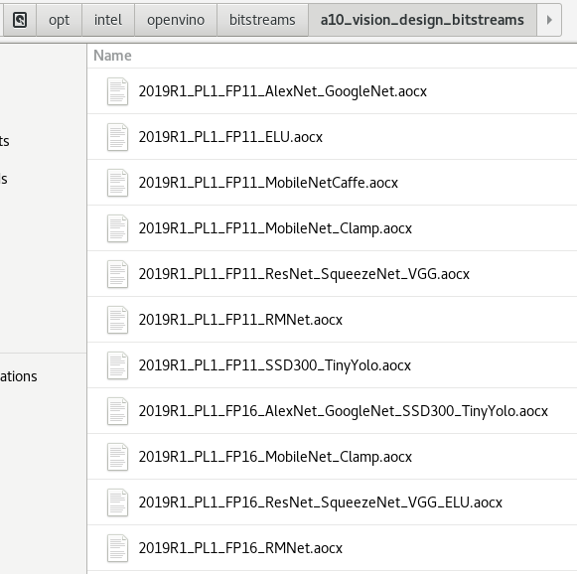
DLA Architecture Selection
Intel® Distribution of OpenVINO™ toolkit ships with many FPGA images for various boards/data types/topologies
<version>_<board>_<data type>_<Topologies/Feature>.aocx
Find ideal FPGA image that meets your needs
Check documentation for list of FPGA images and supported topologies
https://docs.openvinotoolkit.org/latest/_docs_IE_DG_supported_plugins_FPGA.html
Example: ResNet* focused image does not have Norm (better performance)
Notes:
To support various data types and different primitives that are used in different neural networks, the OpenVINO toolkit FPGA package ships with many different bitstreams, which are the FPGA images that are optimized for different boards, different data types and network topologies. Make sure to find the optimal FPGA image for the network and data type you plan to run. The name of the bitstream starts with the version of DLA, then there’s the board name, followed by the data type and then supported topologies or bitstream features.

Slide 12
Load Selected Bitsteam Prior to Execution
Program the FPGA with the selected FPGA bitstream
bitstream file
aocl program acl0 2020_R4_PL11_FP11_MobileNetCaffe.aocx
Utility Program
Enumerated FPGA board
Board
Datatype Support
Network/Primitive Support
Notes:
To program the FPGA, you will need to use this command in a terminal, “aocl” is the utility application, followed with the argument “program”, then the board name “acl0”, and the bitstream name. On Intel DevCloud for the Edge, users can always send the inference workload to an Intel FPGA accelerator.

Slide 13
Intel® Distribution of OpenVINO™ toolkit for Intel® Vision Accelerator Design with an Intel® Arria® 10 FPGA and the Intel® Programmable Acceleration Card with Intel® Arria® 10 GX FPGA Support Change
Intel will be transitioning to the next-generation programmable deep-learning solution based on FPGAs in order to increase the level of customization possible in FPGA deep-learning.
As part of this transition, future standard releases (i.e., non-LTS releases) of Intel® Distribution of OpenVINO™ toolkit will no longer include the Intel® Vision Accelerator Design with an Intel® Arria® 10 FPGA and the Intel® Programmable Acceleration Card with Intel® Arria® 10 GX FPGA.
Intel® Distribution of OpenVINO™ toolkit 2020.3.X LTS release will continue to support Intel® Vision Accelerator Design with an Intel® Arria® 10 FPGA and the Intel® Programmable Acceleration Card with Intel® Arria® 10 GX FPGA.

